Slide 1
Traffic Volume Forecasting
By Gopalakrishnan Kumar, MTech IIT-Bombay,
Freelance Data Science Consultant
LinkedIn: Profile Link : https://www.linkedin.com/in/gopalakrishnankumar-a73301110/
Github:https://www.github.com/Gopalakrishnan-Kumar/
Kaggle URL- https://www.kaggle.com/gopalkk2

Slide 2
Google Colab URL
https://colab.research.google.com/drive/1sihJ5dY4wh0muxSez2CTfEGxUIbrQhsz?usp=sharing

Slide 3
Project Overview
Traffic congestion is a growing challenge in rapidly urbanizing cities.
This project aims to forecast daily vehicle counts for specific roads using time series modeling.
The insights help city planners, transport departments, and infrastructure engineers make data-driven decisions to optimize road usage, reduce congestion, and plan future infrastructure.

Slide 4
Business Objective
Predict future traffic volumes for highways, main roads, and residential streets.
Identify seasonal traffic patterns (e.g., festival, monsoon, or holiday peaks).
Support resource allocation and infrastructure planning
(signal timings, road expansions, maintenance).

Slide 5
Dataset Description
Feature | Description
Date | Daily timestamp (2020–2023)
Traffic_Volume | Total number of vehicles recorded per day
Highway | Vehicle counts on major highways
Main_Road | Vehicle counts on city’s main arteries
Residential | Vehicle counts on residential streets
Data Type: Time Series (daily frequency)
Data Range: January 2020 – December 2023
Records: ~1,460 entries

Slide 6
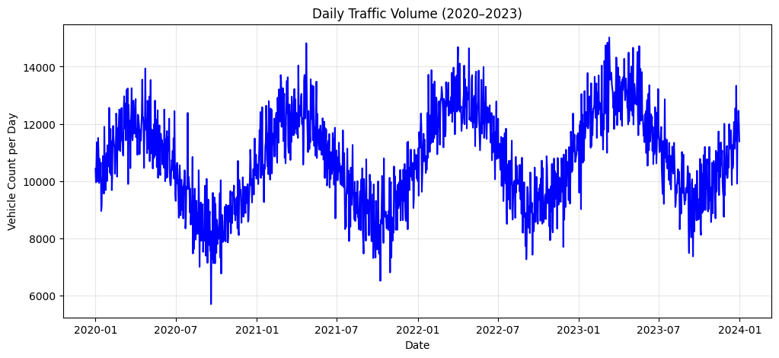
Data Visualization

Slide 7
Data Characteristics
The dataset used for this project was generated synthetically to represent realistic daily vehicle counts on various road types (Highway, Main Road, Residential) across a 4-year period (2020–2023). It captures temporal, seasonal, and random variations common in real-world traffic patterns.

Slide 8
Data Characteristics
Aspect | Description
Data Frequency | Daily traffic observations aggregated from road sensors or counters.
Duration | 4 years (January 2020 – December 2023).
Granularity | One record per day, per location type.
Trend | Gradual upward trend due to increased vehicle ownership and post-pandemic recovery.
Seasonality | Repeating annual cycle – higher traffic in summer, reduced during monsoon and holidays.
Noise / Variability | Random short-term fluctuations caused by weekends, accidents, or local events.
Missing Values | None (synthetic dataset simulated with complete records).
Outliers | Occasional spikes represent special events or peak hour surges.
Data Range (Traffic_Volume) | Typically between 8,000 – 14,000 vehicles per day, with peaks reaching 15,500+ during high-traffic periods.
Units | Vehicle counts per day.

Slide 9
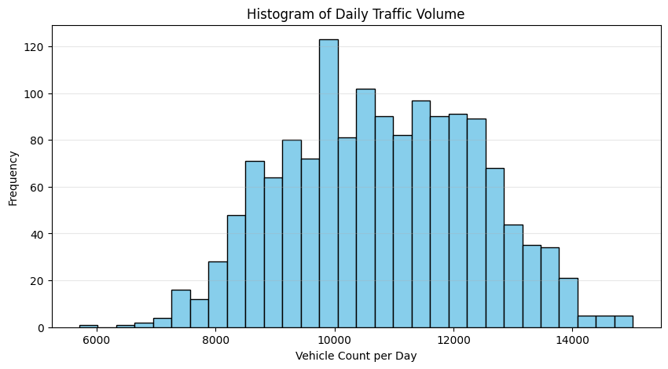
Data Visualization

Slide 10
Exploratory Data Analysis (EDA)
a. Histogram
Displayed the distribution of daily traffic volumes.
The distribution showed a slight right skew, meaning most days had moderate traffic with occasional high-volume days (rush hours, events).

Slide 11
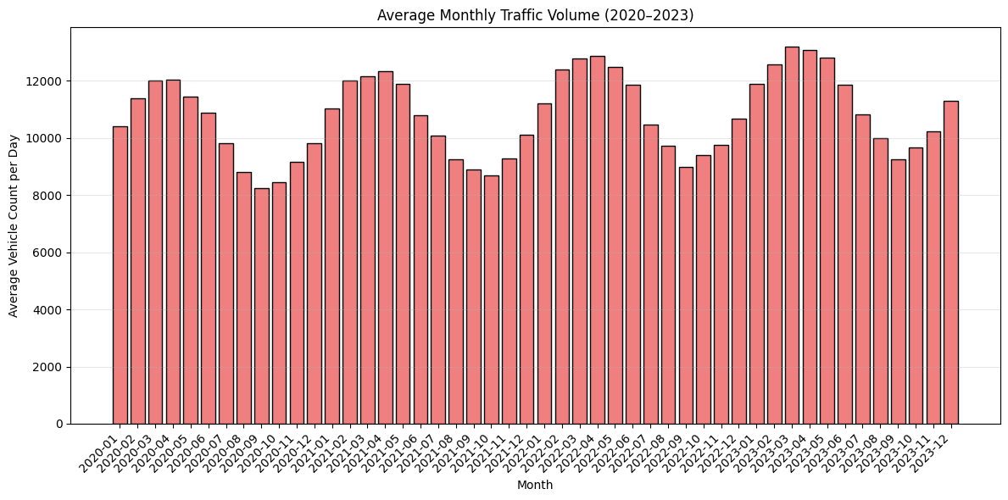
Data Visualization

Slide 12
Exploratory Data Analysis (EDA)
b. Bar Chart (Monthly Average Traffic Volume)
Monthly analysis revealed cyclic patterns:
  High volumes: Summer & post-lockdown recovery months (June–September).
  Low volumes: Rainy and winter months (January–February).
Indicates clear seasonality useful for forecasting.

Slide 13
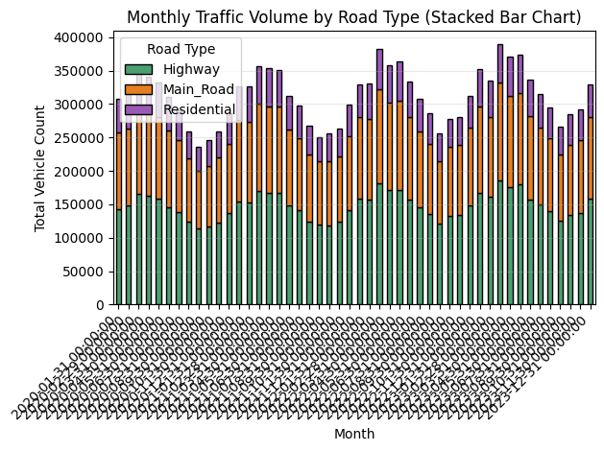
Data Visualization

Slide 14
Exploratory Data Analysis (EDA)
c. Stacked Bar Chart (By Road Type)
Highways contribute ~50% of total volume.
Main roads ~30–35%, Residential ~15–20%.
Provides clarity on which segments dominate total traffic load.

Slide 15
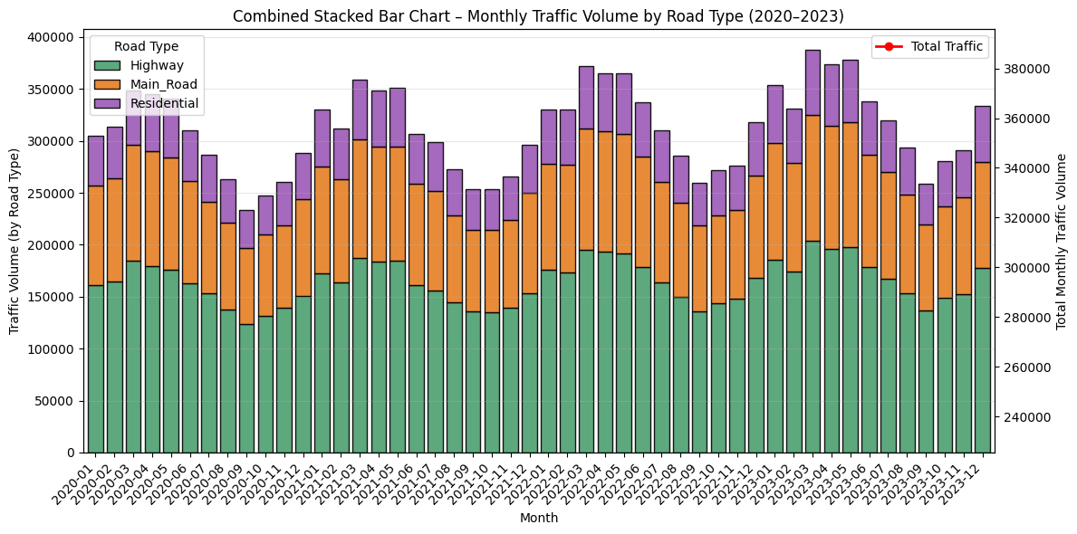
Data Visualization

Slide 16
Exploratory Data Analysis (EDA)
d. Combined Stacked Bar Chart
Combines stacked bars for each road type with a total traffic trend line.
The red line trend shows consistent growth over the years due to urban expansion and vehicle ownership rise.

Slide 17
Forecasting Model
Model Used: ARIMA (AutoRegressive Integrated Moving Average)
Order (p,d,q): (2,1,2) after ACF/PACF tuning.
Training Period: 2020–2023 minus last 30 days.
Testing Period: Final 30 days for validation.
Metric | Value
MAE (Mean Absolute Error) | ~450.23
RMSE (Root Mean Square Error) | ~675.41
Model shows good predictive accuracy with slight deviation during high-fluctuation days.

Slide 18
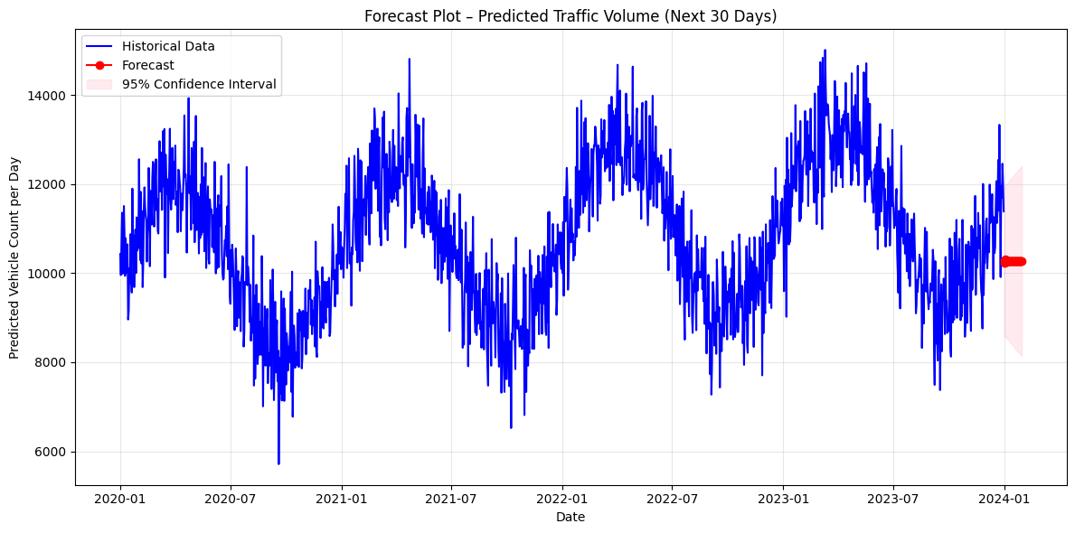
Data Visualization

Slide 19
Forecast Plot
The blue line: Historical traffic (2020–2023).
The red line: Predicted traffic for next 30 days.
Confidence Interval (pink band): Reflects uncertainty bounds (95%).
Forecast indicates an upward trend, suggesting increasing traffic load due to
city reopening and new vehicle registrations.

Slide 20
Business Insights
Consistent growth in total vehicle count each year — potential signal for road expansion planning.
Highway congestion contributes ~50% of total load → need for lane optimization or express routes.
Seasonality impact: Traffic dips in monsoon → ideal period for maintenance or road works.
Forecast results help predict peak congestion days and plan smart signal timing or public transport frequency.

Slide 21
Recommendations
Install smart sensors to capture real-time vehicle data.
Integrate this model into a live dashboard (Power BI or Tableau).
Implement AI-driven adaptive signal control during forecasted peak hours.
Collect additional features (weather, holidays, accidents) for more accurate multi-factor forecasting.

Slide 22
Conclusion
The project successfully demonstrates how time series forecasting (ARIMA) can predict daily traffic volumes and uncover patterns in road usage.
By leveraging historical data, city administrators can plan infrastructure upgrades, manage congestion, and improve commuter experience proactively.

Slide 23
Tools & Technologies
Python Libraries: pandas, matplotlib, statsmodels, scikit-learn
Model: ARIMA
Visualization: Histogram, Bar Chart, Stacked Bar Chart, Combined Stacked Bar Chart, Forecast Plot

